Slide 1
Motivation
Why study Software Engineering ?

Slide 2
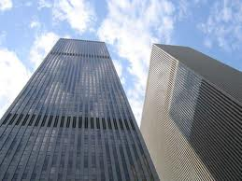
What is Engineering ?
Engineering (Webster)
The application of scientific and mathematical principles to practical ends such as the design, manufacture, and operation of efficient and economical structures, machines, processes, and systems.

Slide 3
Is Software Engineering ?
“Engineering is design under constraint… Engineering is synthetic - it strives to create what can be, but it is constrained by nature, by cost, by concerns of safety, reliability, environmental impact, manufacturability, maintainability and many other such 'ilities.' ...”
William Wulf and George Fisher

Slide 4
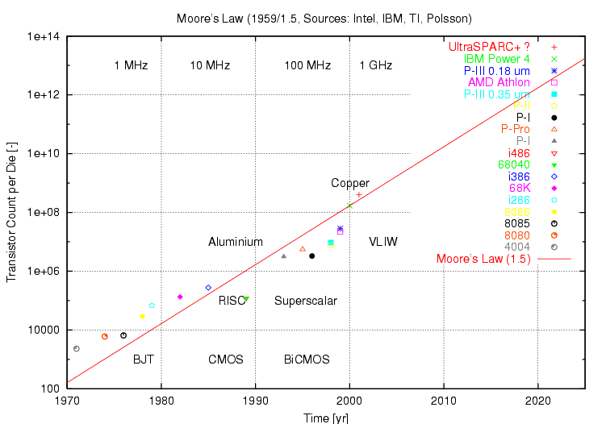
Moore’s Law – Compute Power

Slide 5
Constraints of Software Engineers
Not like those for “real” engineers:
Weight, physics, etc.
Complexity of what we can understand
Most important constraints:
Limits of human memory
Cost of human effort
This class is about managing complexity to efficiently produce reliable, complex software systems.

Slide 6
Why is software difficult to get right ?
Human beings are not accustomed to being perfect, and few areas of human activity demand it. Adjusting to the requirement for perfection is, I think, the most difficult part of learning to program. -Frederick P. Brooks, "The Mythical Man-Month: Essays on Software Engineering, Anniversary Edition (2nd Edition)”, 1965

Slide 7
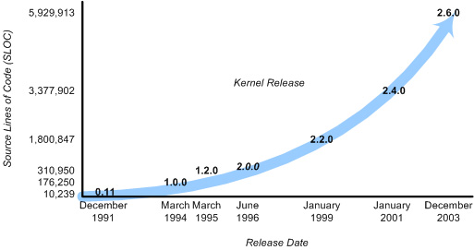
Software Complexity
Growth in size of Linux Kernel between 1991 and 2003

Slide 8
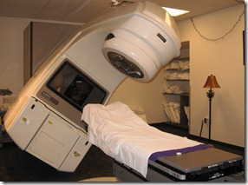
S/W Failure Example 1: Therac-25
Radiation machine produced by Atomic Energy of Canada
In 1986, delivered massive overdoses of radiation injuring 100 patients and killing 3
Caused by a Software error (race condition) that led to the wrong beam being engaged
Main reasons for the failure:
Inadequate testing – one person tested the whole system
Program did not check its internal values for consistency – user-error in data entry went unnoticed by the machine
Did not anticipate errors and degrade gracefully

Slide 9
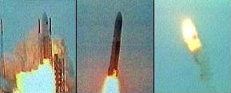
S/W Failure Example 2: Ariane 5
Ariane 5 rocket took off but within seconds veered dangerously from its flight path and self-destructed
Ariane 5 code was ported from Ariane 4 code which had a much smaller range of orbital values.
Ariane 5 needed a wider range of values, which led to the overflow of some of the internal variables.
This caused a software exception. Unfortunately, exception handling was disabled, and hence the entire system crashed.

Slide 10
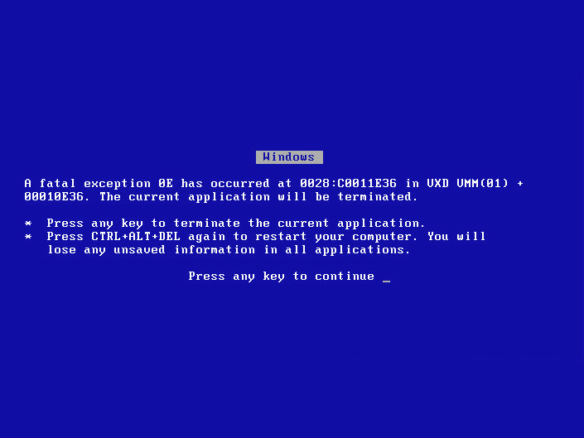
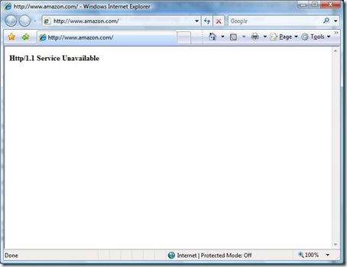
Down-to-earth examples of S/W Failures
Windows BSOD
Amazon.com outage
Can you think of examples from your own experiences ?

Slide 11
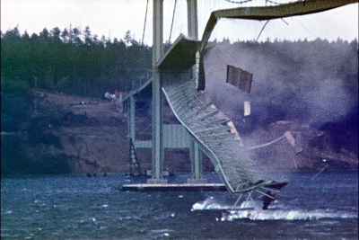
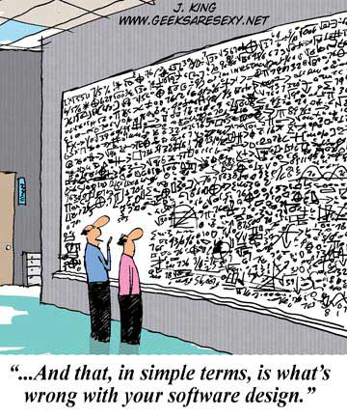
Software Failures Vs. Bridge Failures
Software failures
Failure to adhere to sound design principles
Bridge Failures
Failure to adhere to the laws of physics
Tacoma narrows, 1940

Slide 12
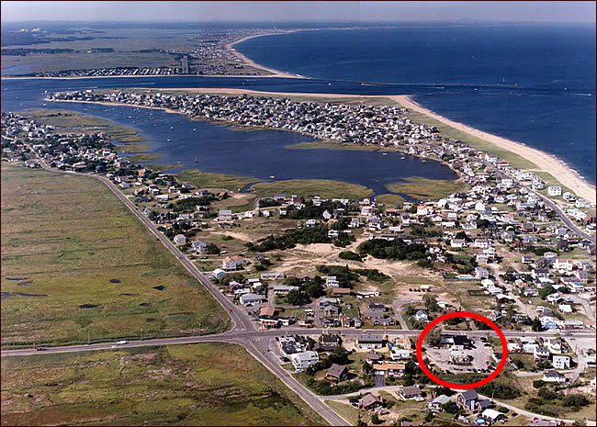
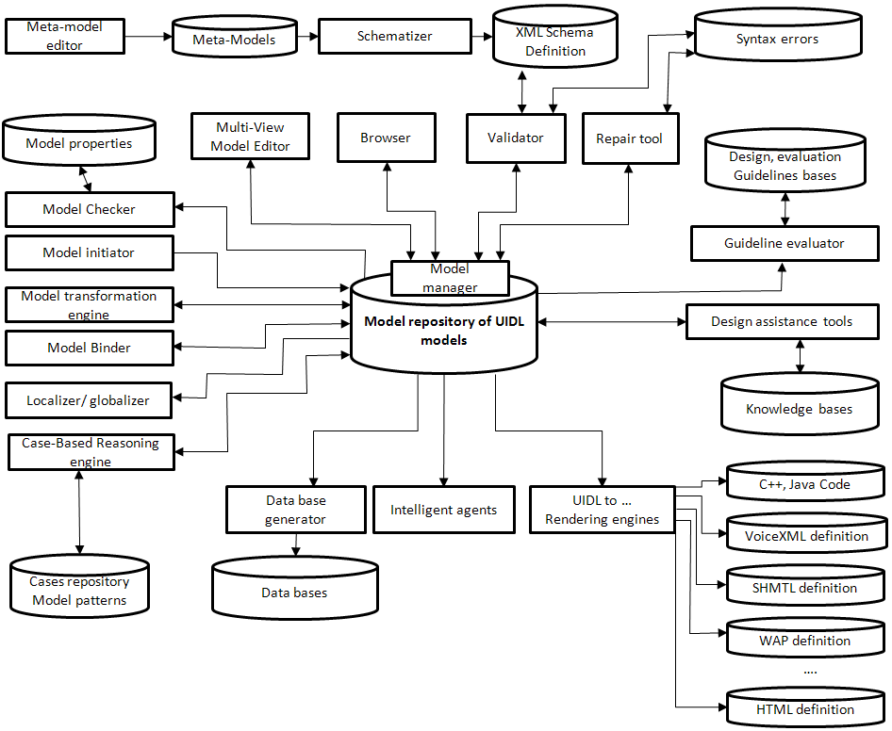
Techniques to reduce the cognitive complexity of software development
Abstraction: Information hiding for divide & conquer
Specifications: Write it down precisely & test it

Slide 13
Specifications …

Slide 14
Summary
Software is everywhere – bugs in software can have serious consequences
Software development (on large scale) is hard
Too many details lead to errors – hard to reason about
Important to reduce the cognitive complexity of software
Abstraction: Art of hiding unimportant details and generalizing across multiple entities
Key technique to enable modular development
Write down precise specifications wherever possible

Slide 15
Further Reading
Fred Brooks, “The mythical man month”, Addison Wesley, 2nd edition, 1995.
Henry Petroski, “To engineer is human: The role of failure in successful design”, 1st edition, 1992.
Nancy Leveson, “Safeware, System Safety and Computers”, Addison-Wesley, 2001.
Software accidents and their provenance

